Slide 1
^{DSI Capstone} ^{12/5 Weekly Update}
Dec 8, 2022

Slide 2
Agenda
1
From Last Week
2
Finalize Business Case Result
3
Final Readout Initial Draft
4
Next Steps

Slide 3
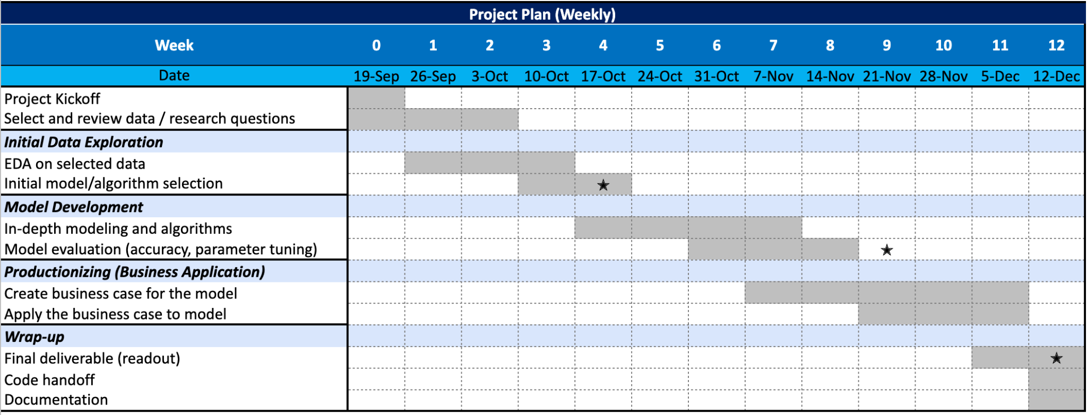
From Last Week: Timeline
1
1st progress report
2nd progress report

Slide 4
From Last Week
1
Action items:
Create final readout for the whole project
Improve business case
Improve ML model

Slide 5
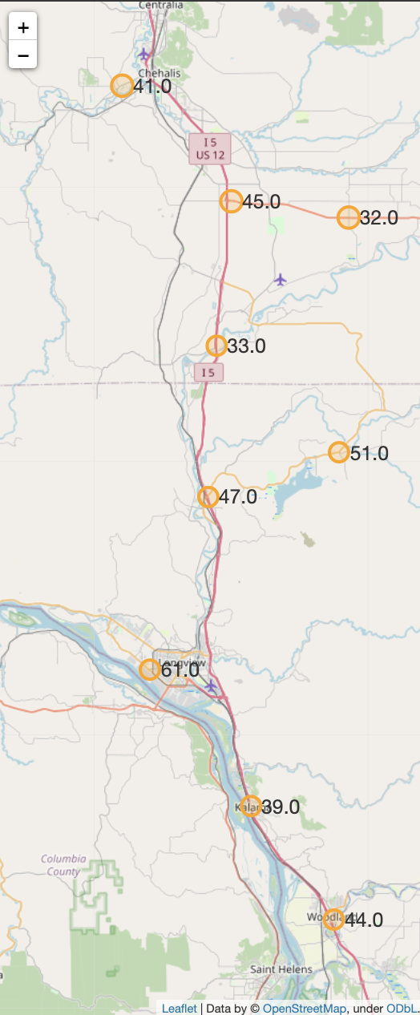
From Last Week: baseline score on optimized locations
1
Considering that we are planning to place more EV chargers in communities that include rural, disadvantaged, and hard-to-reach areas, we include median household income as a feature to penalize score for developed areas
Idea
Create a linear combination on selected features
Features
# of attraction/entertainments within 1 mile driving distance
Crime rate (includes violent crime, murder, rape, robbery, assault, property crime, burglary, larceny theft, motor vehicle theft, arson)
Take total and calculate rate based on population
Natural risk score
Median household income
Weights
All same (1) on all 4 features
Process
Use min-max scaler on each three features to make the number from 0 to 1 on all features
Add each features together based on whether larger number means worser:
1*# of attractions in 1 miles - 1*total crime rate - 1*natural risk score - 1*median household income
Use min-max scaler on the score to make them from 0 to 1
Query the score on optimized locations
Notes:
Mutually exclusive here: no consideration for distance from exists and traffic since used them in optimization

Slide 6
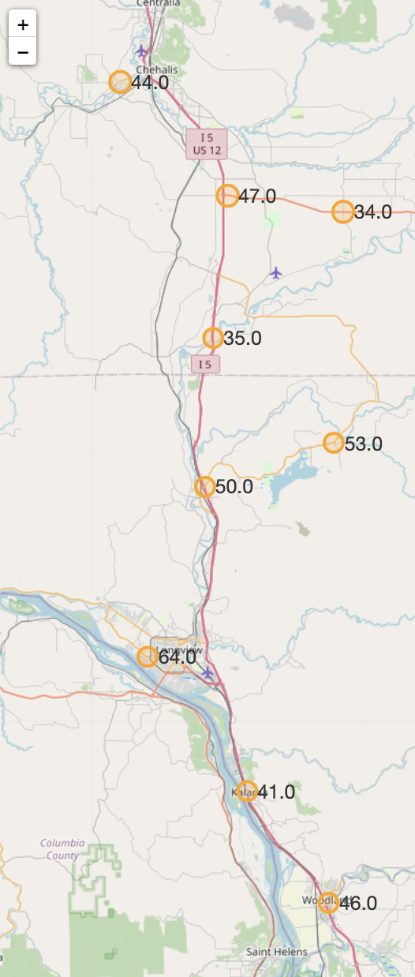
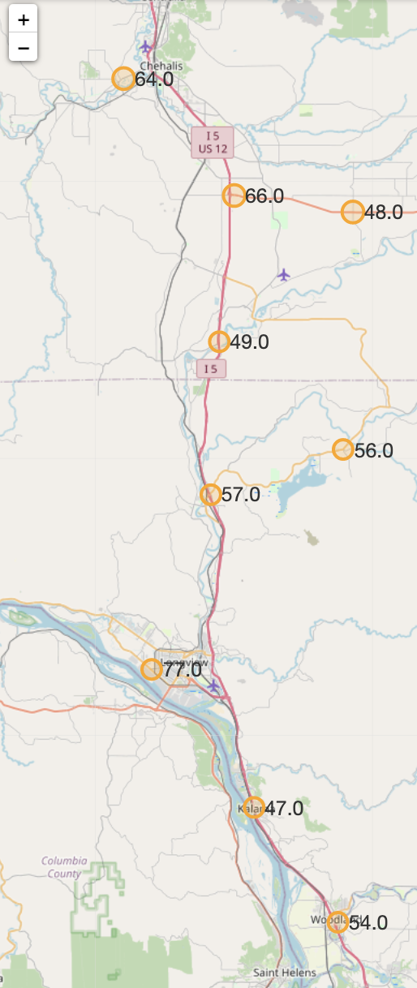
From Last Week: baseline score with different weights (manually)
1
Score formula: a*# of attractions in 1 miles - b*total crime rate - c*natural risk score - d*median household income
Equal weight
Decrease weight on attraction
Increase weight on median household income
Even the actual scores increased, the relative importance of these stations among all others stays the same
the relative importance of these two stations flipped as we increase the weight on median household income
Weights:
a: 1
b: 1
c: 1
d: 1
Weights:
a: 0.5
b: 1
c: 1
d: 1
Weights:
a: 0.5
b: 1
c: 1
d: 2
: Model suggested EV charging location
# : predicted score
: Highest score location

Slide 7
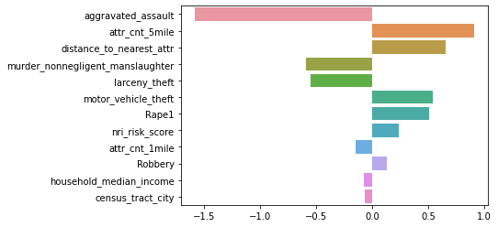
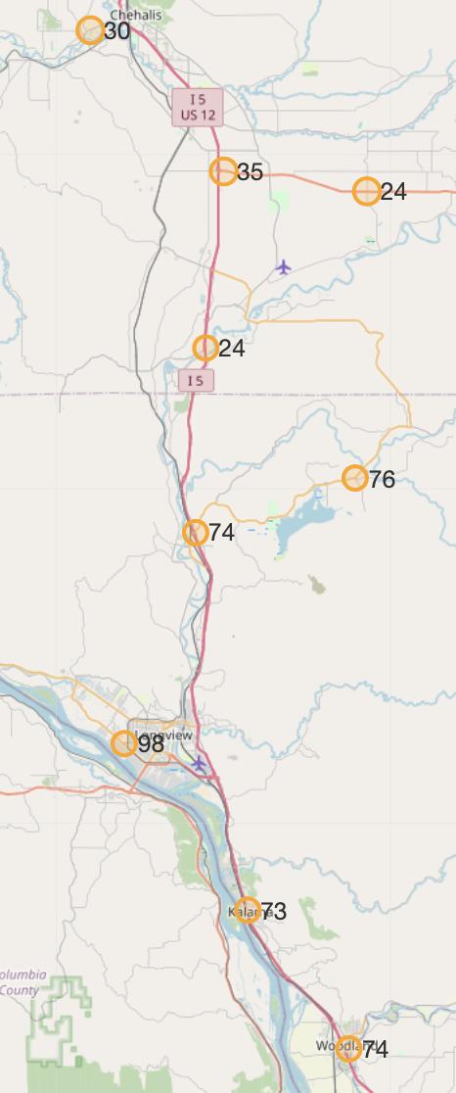
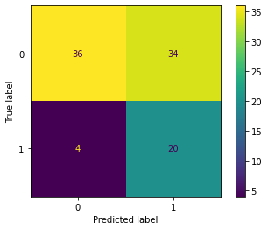
From Last Week: logistic regression have counterintuitive result
1
Comparatively small dataset
: Modeled EV charging location
# : predicted score
: Highest score location
Binary target
Feature Importance
Easy to interpret
Scores here are relatively much lower than expected in baseline model
Logistic Regression
Model Deployment
The general score pattern is similar to the unweighted baseline score
Recall: ~83%
Average Precision: ~40%
Accuracy: ~60%
Similar model performance compared to tree-based models
Model Performance
We don’t care whether the model predicted unmatched gas stations as EV because our goal is to have more EV stations
Scores here are relatively higher than expected in baseline model
Notes:
Feature importance result corresponds to our expectation - crime rate, natural risk index and traffic

Slide 8
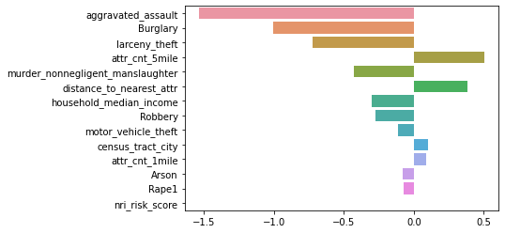
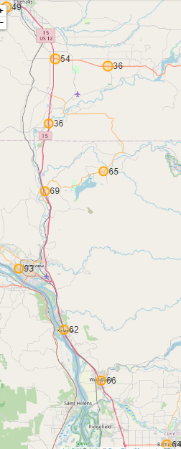
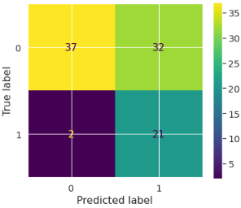
Business Case: improved logistic regression (removed counterintuitive data)
2
Comparatively small dataset
: Modeled EV charging location
# : predicted score
: Highest score location
Binary target
Feature Importance
Easy to interpret
Scores here are smaller than in baseline model, however, the relative scores are the same
Logistic Regression
Model Deployment
Decisions are the same as Baseline model
Recall: ~91%
Average Precision: ~40%
Accuracy: ~63%
Similar model performance compared to tree-based models
Model Performance
We don’t care whether the model predicted unmatched gas stations as EV because our goal is to have more EV stations
The highest score location is the same as the baseline model
Notes:
Feature importance result corresponds to our expectation - crime rate, natural risk index and traffic

Slide 9
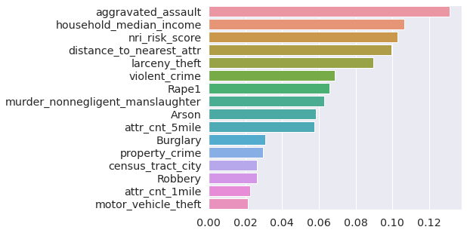
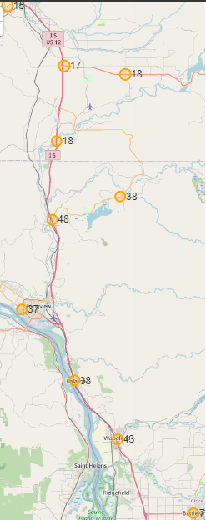
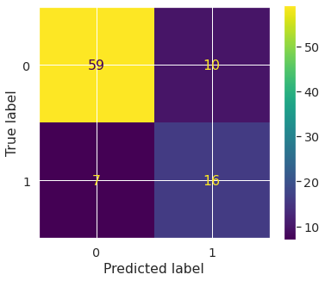
Business Case: improved random forest regression
2
Compatible with all types of data
: Model suggested EV charging location
# : predicted score
: Highest score location
Feature Importance
Avoid Overfitting
Random Forest
Model Deployment
Scores here are relatively lower than in baseline model, however, these four locations will be picked in the baseline model as well
Recall: ~70%
Average Precision: ~62%
Accuracy: ~82%
Better performance compared to boosting (xgboost)
Model Performance
The model performance is comparatively good
Notes:
Feature importance result corresponds to our expectation - crime rate, natural risk index and traffic

Slide 10
Final Readout
3
Final Readout
Notes:
Feature importance result corresponds to our expectation - crime rate, natural risk index and traffic

Slide 11
Next Steps
4
Action items:
Finish final readout for the whole project
Wrap up codes of analysis and models and prepare for handover

Slide 12
Appendix

Slide 13
Python Libraries Used
pandas: 1.3.5
numpy: 1.21.6
gurobipy: 9.5.2
geopy: 1.17.0
folium: 0.12.1.post1
requests: 2.23.0
json: 2.0.9

